Slide 1
Artificial Intelligence
Knowledge Representation

Slide 2
Knowledge and Reasoning
Representation, Reasoning and Logic
Propositional Logic
First-Order Logic
Inference in first-order logic
  Generalized Modus Ponens
  Forward and backward chaining
  Resolution
Logical Reasoning Systems

Slide 3
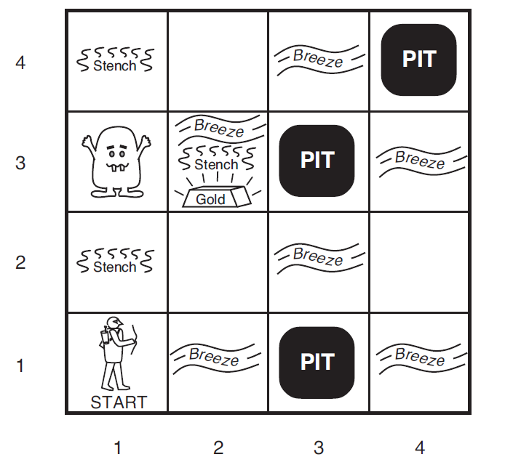
The Wumpus World Environment
A typical wumpus world. The agent is in the bottom left corner, facing right.

Slide 4
Sensors Configuration
Sensors: The agent has five sensors, each of which gives a single bit of information:
– In the square containing the wumpus and in the directly (not diagonally) adjacent squares, the agent will perceive a Stench.
– In the squares directly adjacent to a pit, the agent will perceive a Breeze.
– In the square where the gold is, the agent will perceive a Glitter.
– When an agent walks into a wall, it will perceive a Bump.
– When the wumpus is killed, it emits a woeful Scream that can be perceived anywhere in the cave.

Slide 5
Actuators:
The agent can move Forward, TurnLeft by 90◦, or TurnRight by 90◦. The
agent dies a miserable death if it enters a square containing a pit or a live wumpus. (It is safe, albeit smelly, to enter a square with a dead wumpus.)
If an agent tries to move forward and bumps into a wall, then the agent does not move. The action Grab can be used to pick up the gold if it is in the same square as the agent.
The action Shoot can be used to fire an arrow in a straight line in the direction the agent is facing.
The arrow continues until it either hits (and hence kills) the wumpus or hits a wall. The agent has only one arrow, so only the first Shoot action has any effect.
Finally, the action Climb can be used to climb out of the cave, but only from square [1,1].

Slide 6
The Wumpus World Environment
Adjacent refers to left, right, top, and bottom (not diagonal)
Stench: In squares containing and adjacent to wumpus
Breeze: In squares adjacent to a pit
There can be one wumpus, one gold, and many pits. Agent starts from the bottom-left square of a grid.
The agent dies if it enters a square containing a pit or the wumpus
The agent can shoot the wumpus along a straight line
The agent has only one arrow

Slide 7
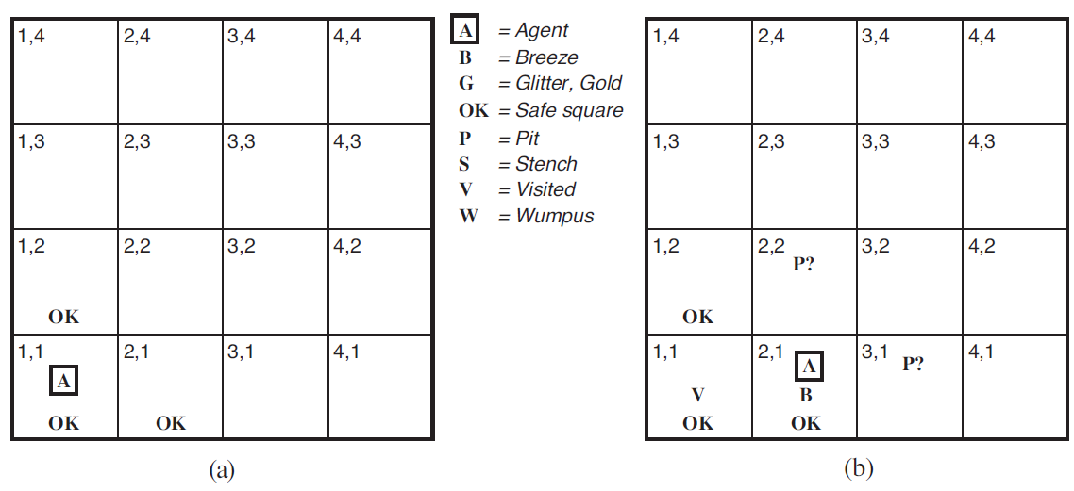
The first step taken by the agent in the wumpus world. (a) The initial situation, after percept [None, None, None, None, None].
(b) After one move, with percept [None, Breeze, None, None, None].

Slide 8
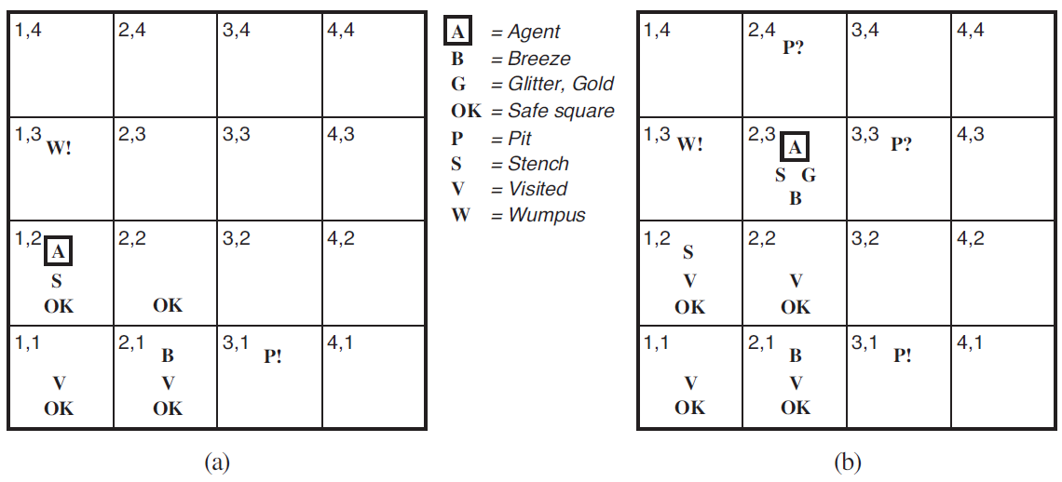
Two later stages in the progress of the agent. (a) After the third move,
with percept [Stench, None, None, None, None]. (b) After the fifth move, with percept [Stench, Breeze,Glitter, None, None].

Slide 9
Logic
A formal system for describing states of affairs, consisting of:
  The syntax of the language, which describes how to make sentences, and
  The semantics of the language, which describes the relation between the sentences and the states of affairs
A proof theory – a set of rules for deducing the entailments of a set of sentences
Improper definition of logic, or an incorrect proof theory can result in absurd reasoning

Slide 10
Types of Logics
Language | What exists | Belief of agent
Propositional Logic | Facts | True/False/Unknown
First-Order Logic | Facts, Objects, Relations | True/False/Unknown
Temporal Logic | Facts, Objects, Relations, Times | True/False/Unknown
Probability Theory | Facts | Degree of belief 0..1
Fuzzy Logic | Degree of truth | Degree of belief 0..1

Slide 11
Propositional Logic
Given a set of atomic propositions AP
Sentence → Atom | ComplexSentence
Atom → True | False | AP
ComplexSentence → ( Sentence )
| Sentence Connective Sentence
| ¬ Sentence
Connective → ∧ | ∨ | ⇔ | ⇒

Slide 12
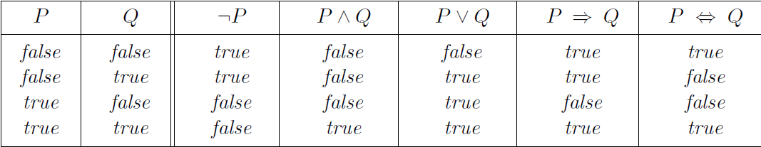
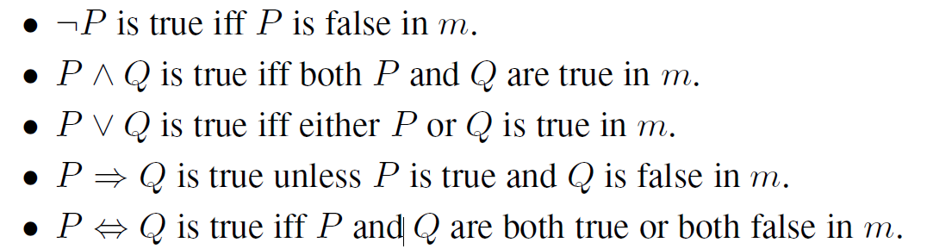

Understanding Truth Table
$A⇒B≡¬A ∨B≡¬B⇒¬A$
$A⇔B≡¬A ∨B∧¬B ∨A$

Slide 13
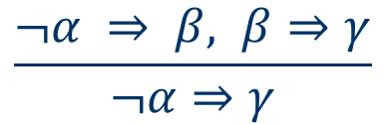


Inference Rules
Modus Ponens or Implication Elimination:
Unit Resolution:
Resolution: or
…. and several other rules
$$\frac{α ∨β ¬β}{α}$$
$$\frac{α ∨β, ¬β∨γ}{α∨γ}$$
$$\frac{¬α ⇒ β, β⇒γ}{¬α⇒γ}$$

Slide 14
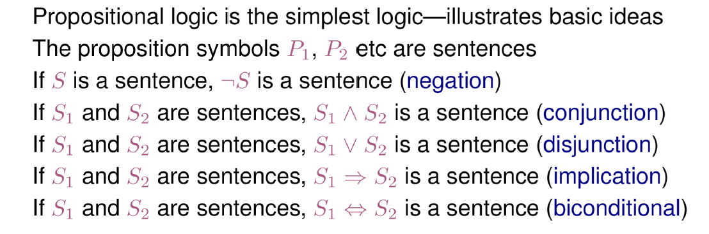
Propositional Logic: Syntax

Slide 15
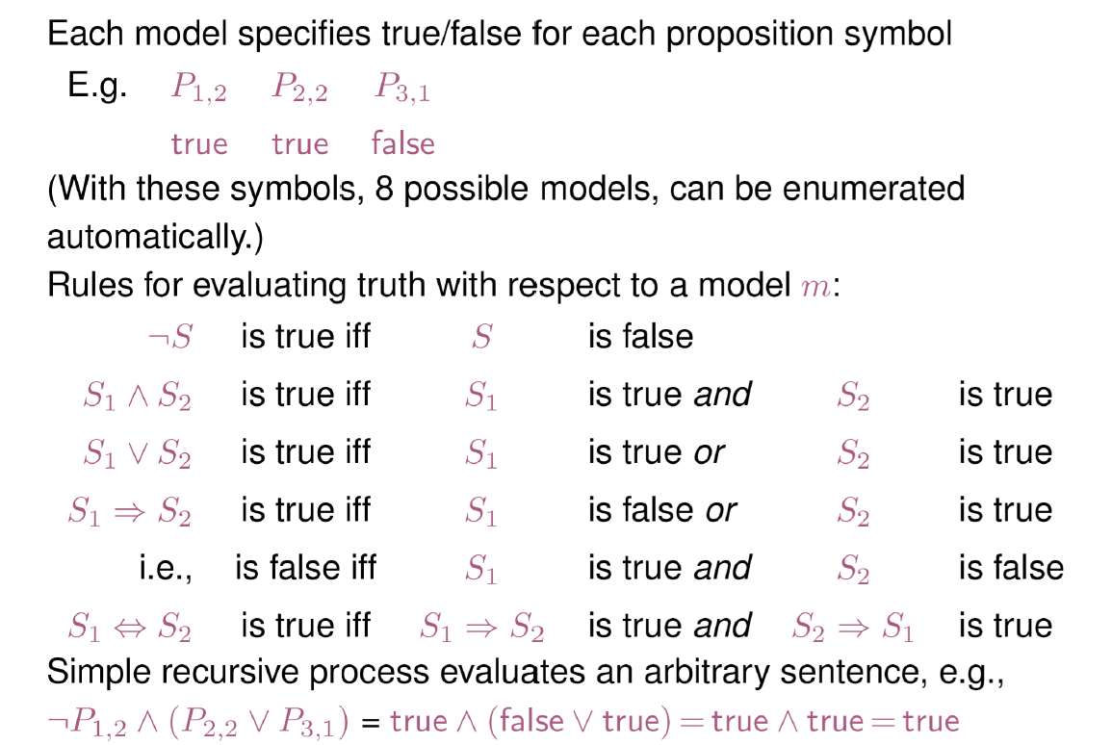
Propositional Logic: Semantics

Slide 16
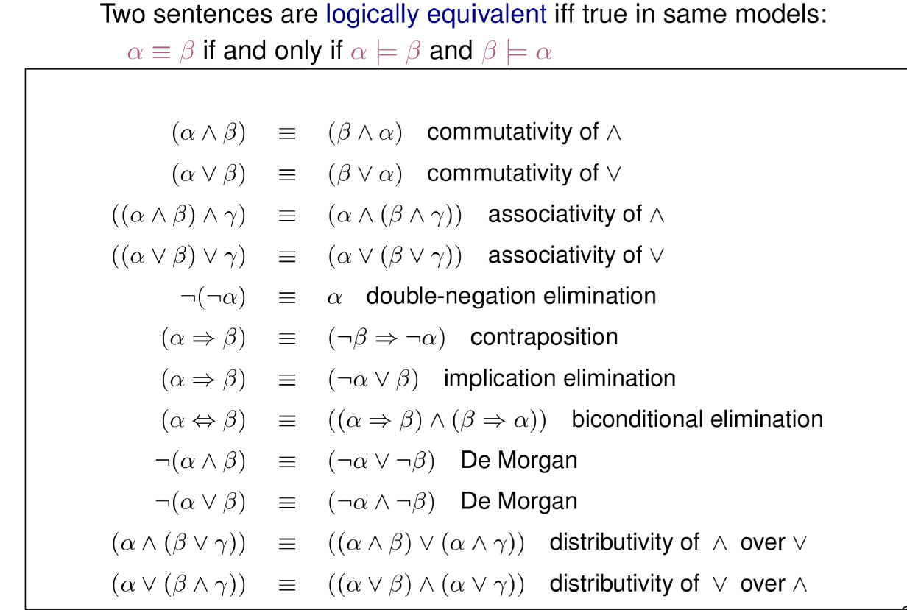
Logical Equivalence

Slide 17
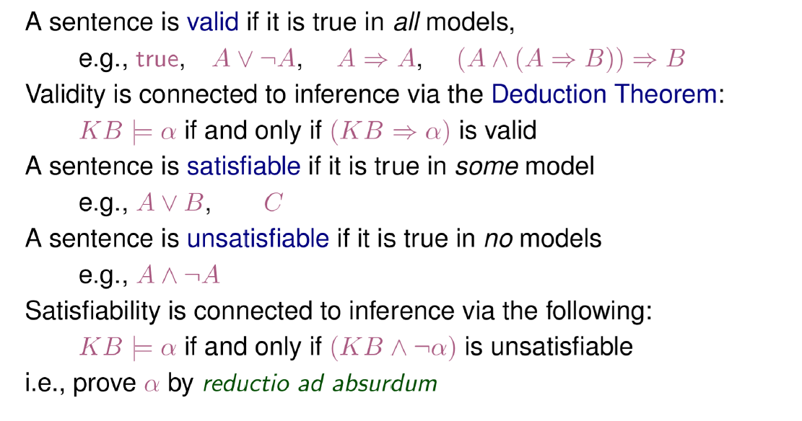

Validity and Satisfiability
$$F_{1}∧F_{2}∧F_{3}…..∧F_{k}⇒G (valid)$$
$${ψ=¬(F}_{1}∧F_{2}∧F_{3}…..∧F_{k})∨G (valid)$$
$${¬ψ=F}_{1}∧F_{2}∧F_{3}…..∧F_{k}∧ ¬G (unsatisfiable)$$

Slide 18
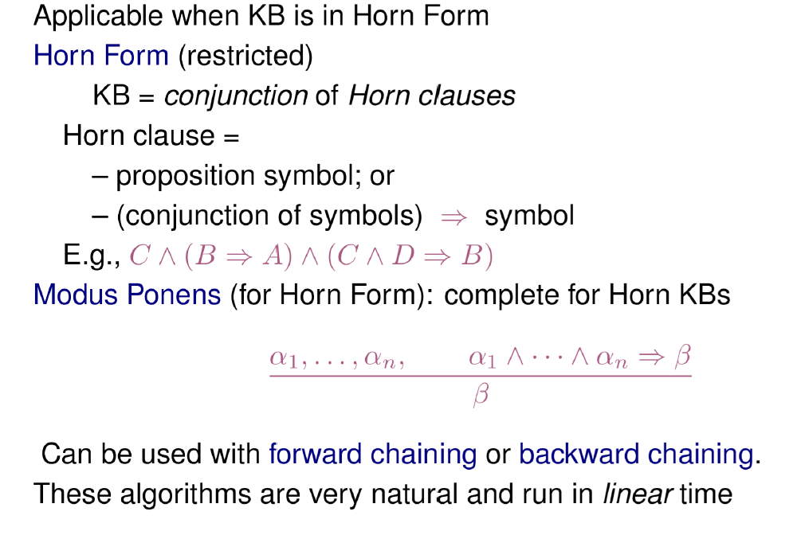
Forward and backward Chaining

Slide 19
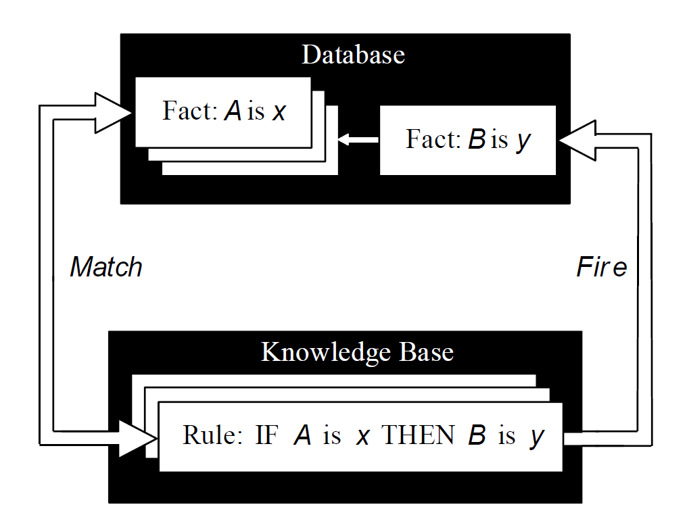
Inference Engine Cycles via a Match-Fire Procedure

Slide 20
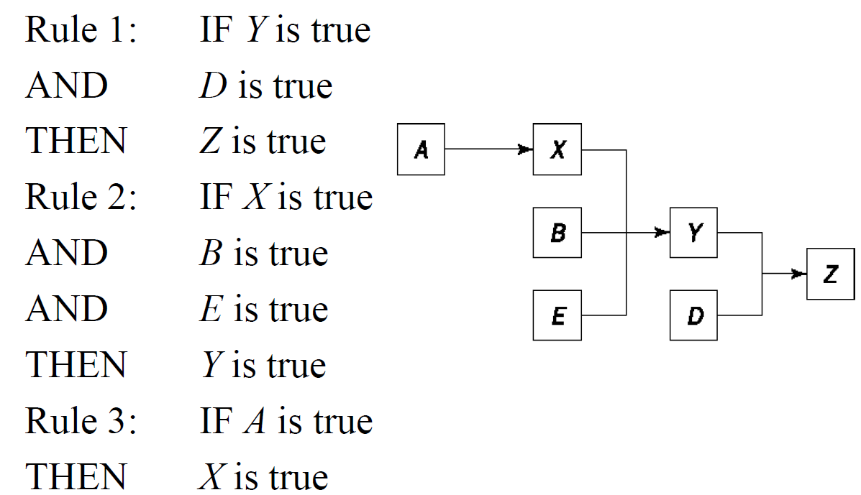
An Example of an Inference Chain

Slide 21
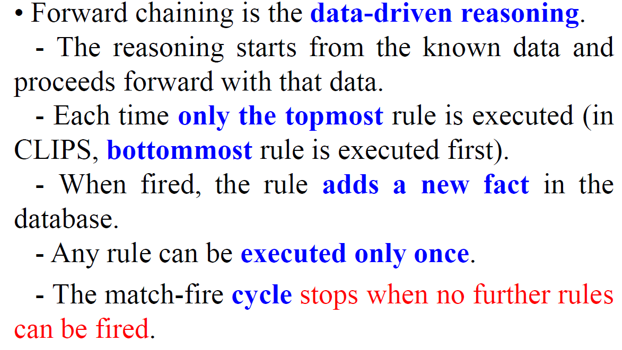
Forward Chaining (FC) Technique

Slide 22
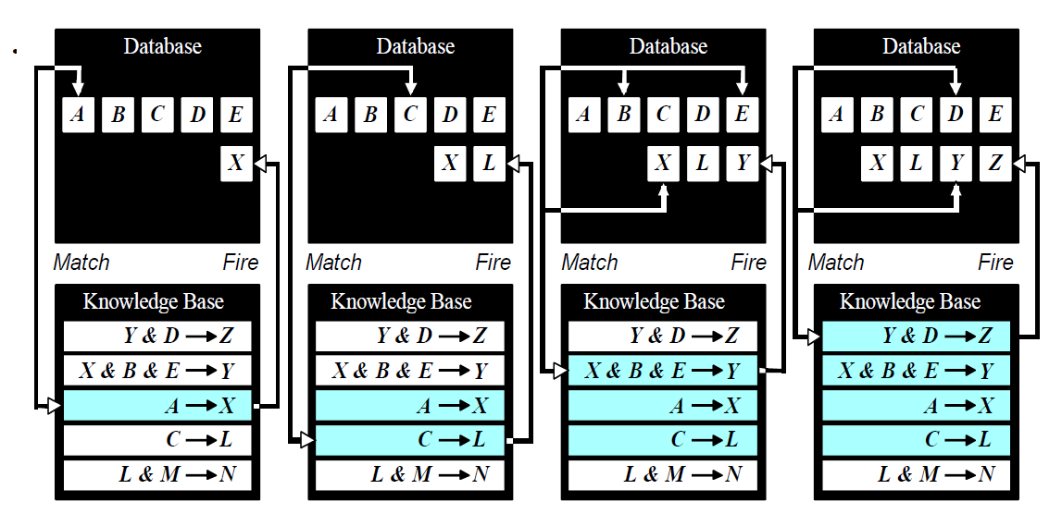

Slide 23
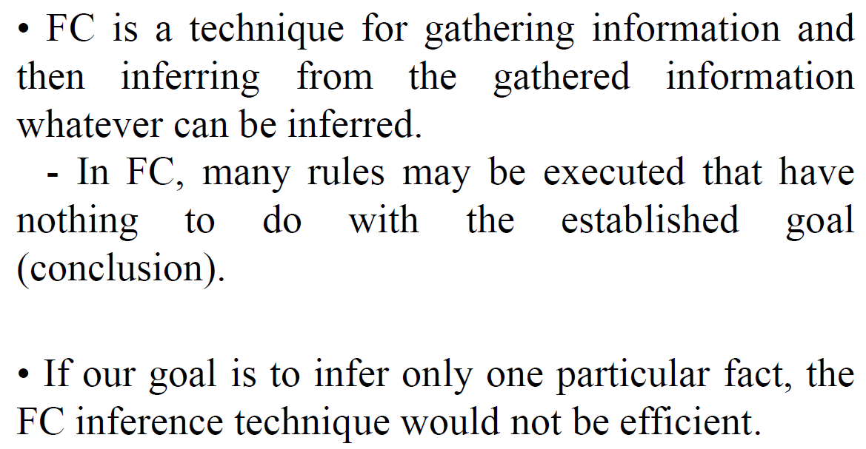

Slide 24
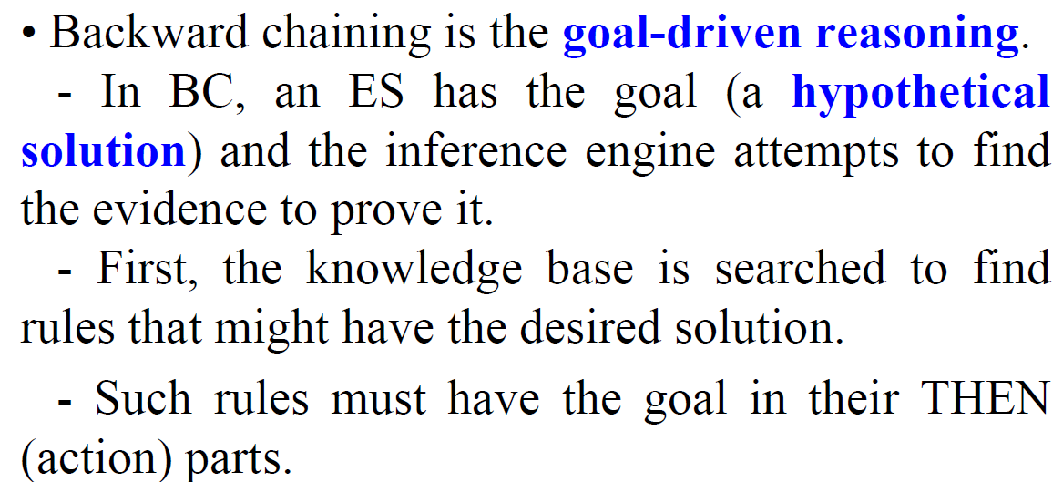
Backward Chaining (BC) Technique

Slide 25
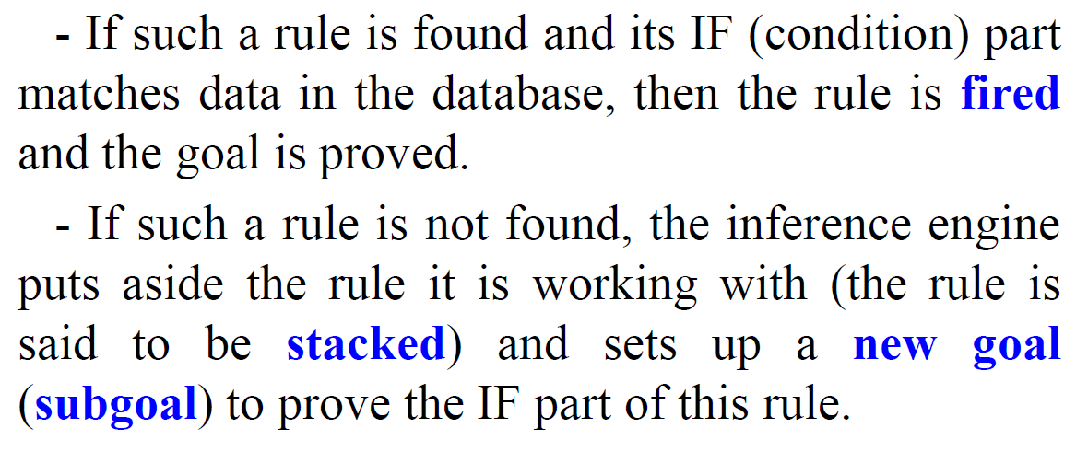
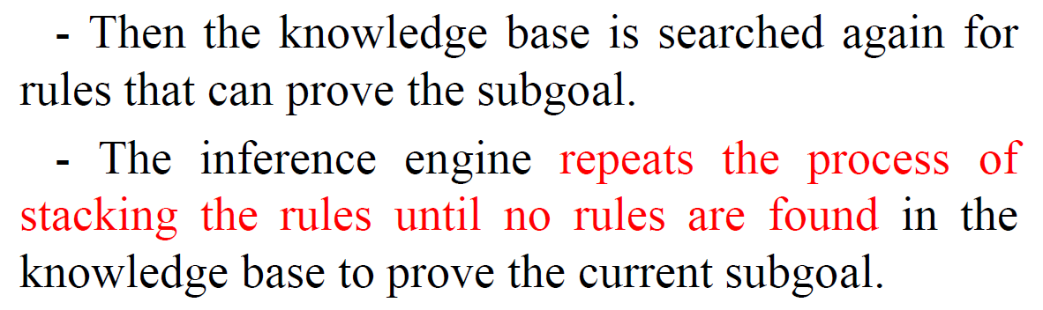
Backward Chaining (BC) Technique

Slide 26
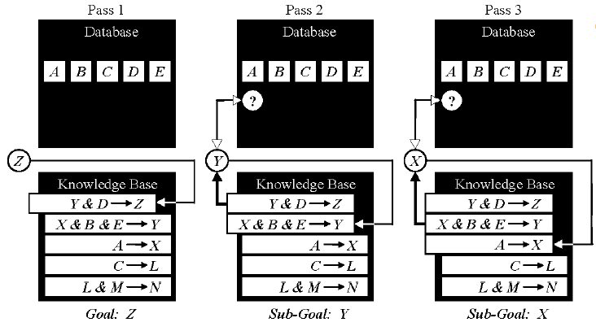
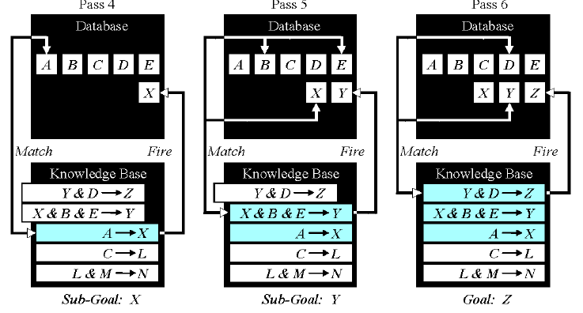

Slide 27
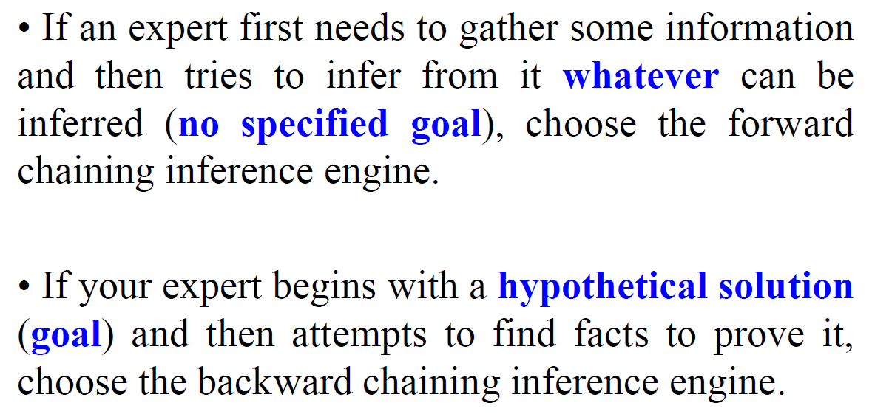
How Do We Choose Between FC and BC

Slide 28
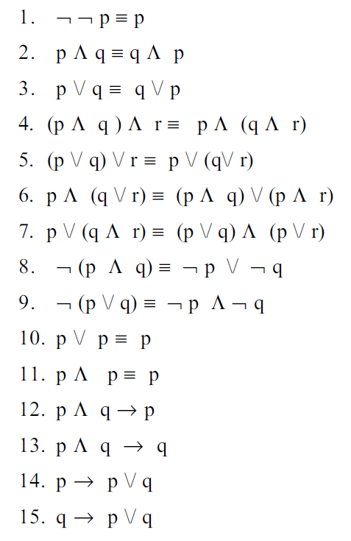
List of tautologies in propositional logic

Slide 29
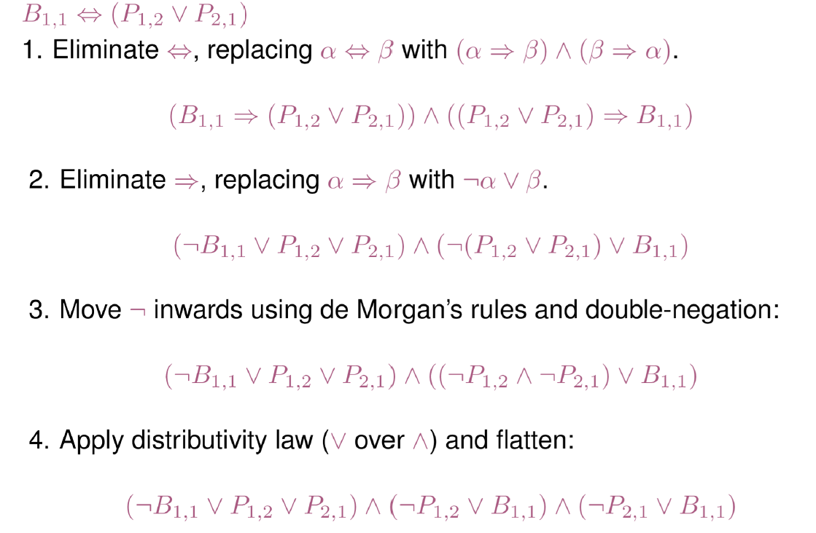
Conversion to CNF

Slide 30
Modeling in propositional logic
Propositions
Umyth: Unicorn is mythical
Umort: Unicorn is mortal
Umam: Unicorn is mammal
Umag: Unicorn is either magical
Uhorn: Unicorn is horned

Slide 31
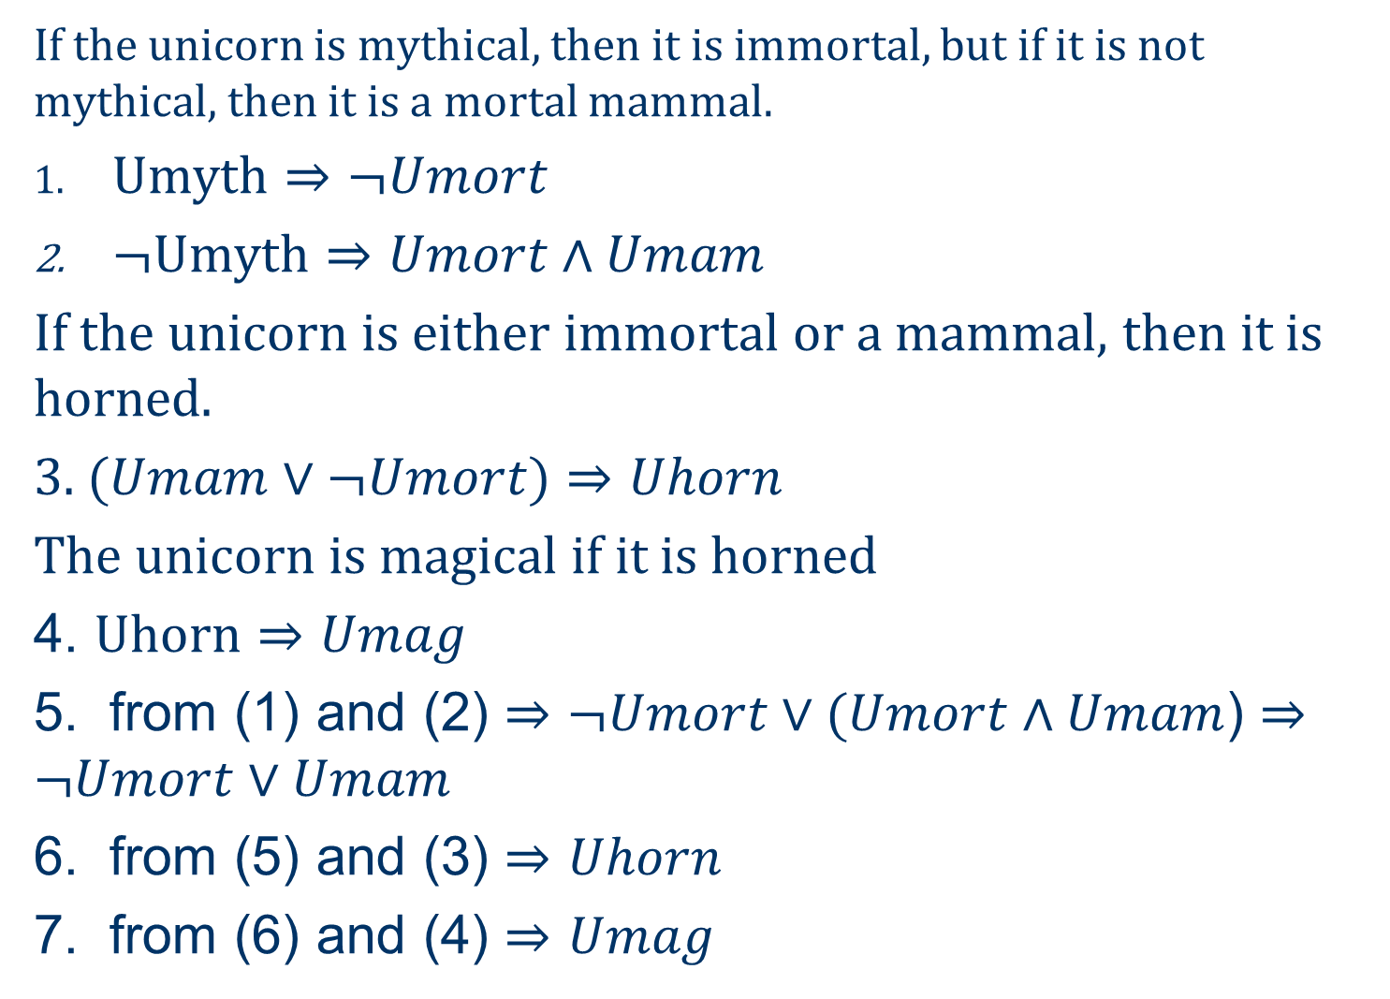
If the unicorn is mythical, then it is immortal, but if it is not mythical, then it is a mortal mammal.
$\text{Umyth}⇒¬Umort$
$¬\text{Umyth}⇒Umort∧Umam$
If the unicorn is either immortal or a mammal, then it is horned.
3. $(Umam∨¬Umort)⇒Uhorn$
The unicorn is magical if it is horned
4. $\text{U}\text{horn}⇒Umag$
5. from (1) and (2) $⇒¬Umort∨(Umort∧Umam$) $⇒¬Umort∨Umam$
6. from (5) and (3) $⇒$ $Uhorn$
7. from (6) and (4) $⇒$ $Umag$

Slide 32
First-order logic
Whereas propositional logic assumes the world contains facts,
first-order logic (like natural language) assumes the world contains
  Objects: people, houses, numbers, colors, baseball games, wars, …
  Relations: red, round, prime, brother of, bigger than, part of, comes between, …
  Functions: father of, best friend, one more than, plus, …

Slide 33
Syntax of FOL: Basic elements
Constants KingJohn, 2, CU,...
Predicates Brother, >,...
Functions Sqrt, LeftLegOf,...
Variables x, y, a, b,...
Connectives ¬, ⇒, ∧, ∨, ⇔
Equality =
Quantifiers ∀, ∃

Slide 34
constant symbols: which stand for objects;
predicate symbols, which stand for relations
function symbols, which stand for functions
For example, we might use the constant symbols Richard and John; the predicate symbols Brother , OnHead, Person, King, and Crown; and the function symbol LeftLeg.

Slide 35


Predicate
$$P(x, y, z)$$
Predicate:
$$∀x ∀y ∀z P(x, y, z)$$
$$∃x ∀y ∃z P(x, y, z)$$
$$∀y ∃x ∃z P(x, y, z)$$

Slide 36
First-order Logic
Sentence → AtomicSentence
| Sentence Connective Sentence
| Quantifier Variable, … Sentence
| ¬ Sentence
| (Sentence)
AtomicSentence → Predicate(Term, …) | Term = Term
Term → Function(Term, …) | Constant | Variable
Connective → ⇒ | ∧ | ∨ | ⇔
Quantifier → ∀ | ∃
Constant → A | 5 | Kolkata | …
Variable → a | x | s | …
Predicate → Before | HasColor | Raining | …
Function → Mother | Cosine | Headoflist | …

Slide 37

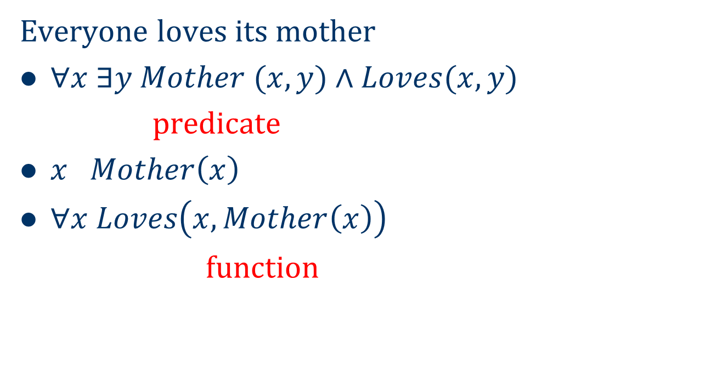
Everyone loves its mother
$∀x ∃y Mother (x, y)∧Loves(x, y)$
predicate
$x Mother\left(x\right)$
$∀x Loves\left(x, Mother\left(x\right)\right)$
function
$$∃p ∀x ∀y p(x,y)$$

Slide 38
Examples
Other examples:
  Not all students take both History and Biology
  Only one student failed History
  Only one student failed both History and Biology
  The best score in History is better than the best score in Biology
  No person likes a professor unless the professor is smart
  Politicians can fool some of the people all the time, and they can fool all the people some of the time, but they cant fool all the people all the time

Slide 39
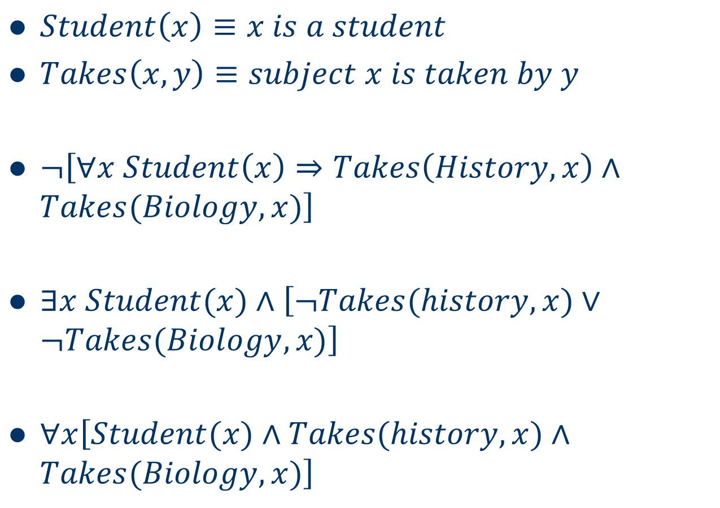
  Not all students take both History and Biology
$Student\left(x\right)≡x is a student$
$Takes\left(x,y\right)≡subject x is taken by y$
$¬\left[∀x Student\left(x\right)⇒Takes\left(History,x\right)∧Takes(Biology,x)\right]$
$∃x Student(x)∧\left[¬Takes(history, x)∨¬Takes(Biology,x)\right]$
$∀x\left[Student(x)∧Takes(history,x)∧Takes(Biology,x)\right]$

Slide 40
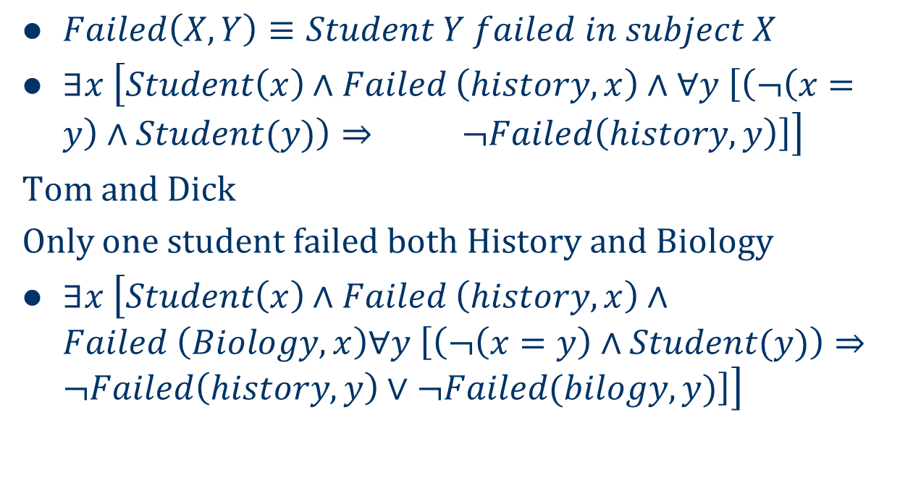
Only one student failed History
$Failed\left(X,Y\right)≡Student Y failed in subject X$
$∃x \left[Student\left(x\right)∧Failed \left(history,x\right)∧∀y \left[\left(¬\left(x=y\right)∧Student(y)\right)⇒ ¬Failed\left(history,y\right)\right]\right]$
Tom and Dick
Only one student failed both History and Biology
$∃x \left[Student\left(x\right)∧Failed \left(history,x\right)∧Failed \left(Biology,x\right)∀y \left[\left(¬\left(x=y\right)∧Student(y)\right)⇒¬Failed\left(history,y\right)∨¬Failed(bilogy,y)\right]\right]$

Slide 41
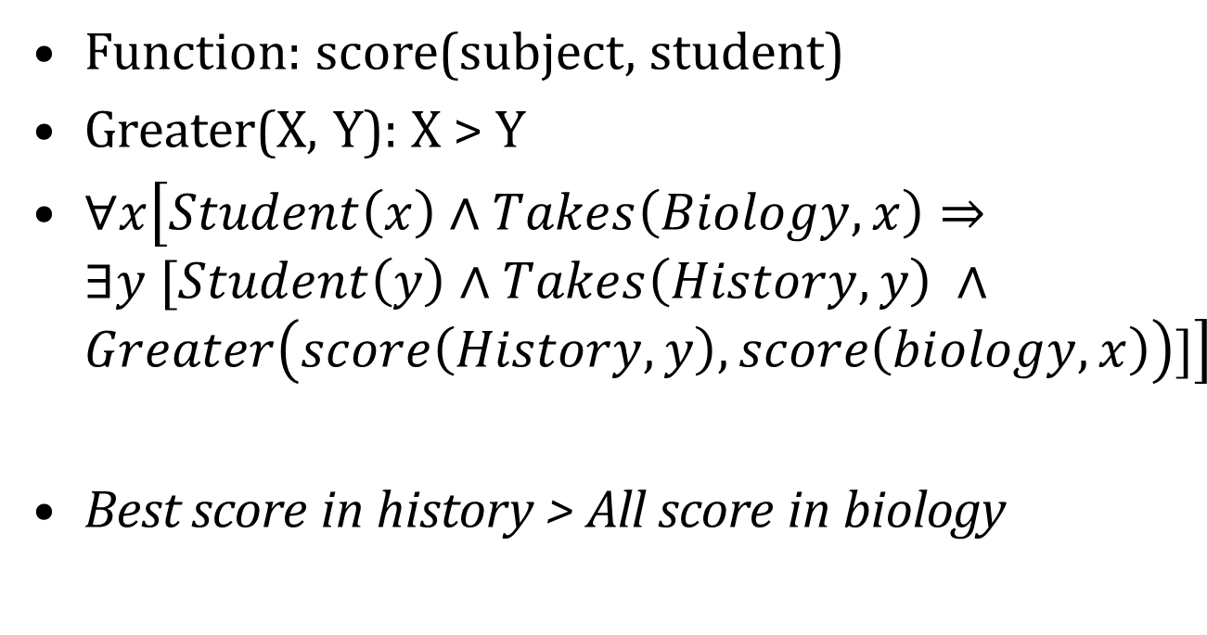
The best score in History is better than the best score in Biology
Function: score(subject, student)
Greater(X, Y): X > Y
$∀x\left[Student\left(x\right)∧Takes\left(Biology, x\right)⇒∃y [Student\left(y\right)∧Takes\left(History, y\right) ∧Greater\left(score\left(History,y\right), score\left(biology,x\right)\right)]\right]$
Best score in history > All score in biology

Slide 42
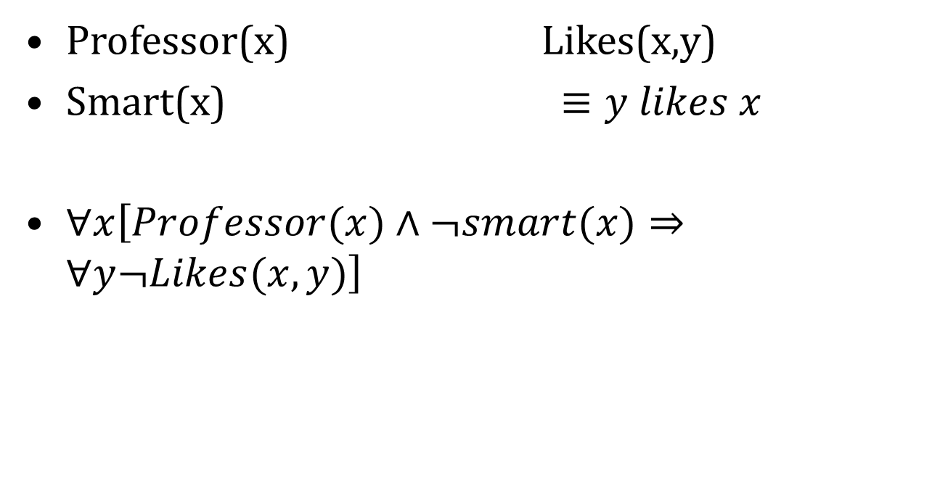
No person likes a professor unless the professor is smart
Professor(x) Likes(x,y)
Smart(x) $≡y likes x$
$∀x\left[Professor(x)∧¬smart(x)⇒∀y¬Likes(x,y)\right]$

Slide 43
Atomic sentences
Atomic sentence = predicate (term₁,...,term_{n}) or term₁ = term₂
Term = function (term₁,...,term_{n}) or constant or variable
E.g., Brother(KingJohn, RichardTheLionheart) > (Length(LeftLegOf(Richard)), Length(LeftLegOf(KingJohn)))

Slide 44
Complex sentences
Complex sentences are made from atomic sentences using connectives
¬S, S₁ ∧ S₂, S₁ ∨ S₂, S₁ ⇒ S₂, S₁ ⇔ S₂,
E.g. Sibling(KingJohn,Richard) ⇒ Sibling(Richard,KingJohn)
>(1,2) ∨ ≤ (1,2)
>(1,2) ∧ ¬ >(1,2)

Slide 45
Truth in first-order logic
Sentences are true with respect to a model and an interpretation
Model contains objects (domain elements) and relations among them
Interpretation specifies referents for
  constant symbols → objects
  predicate symbols → relations
  function symbols → functional relations
An atomic sentence predicate(term₁,...,term_{n}) is true
iff the objects referred to by term₁,...,term_{n}
are in the relation referred to by predicate

Slide 46
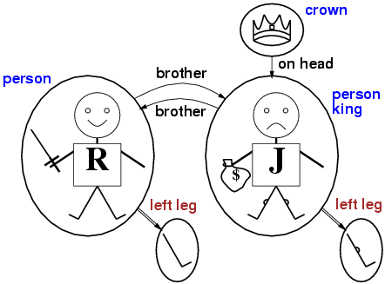
Models for FOL: Example

Slide 47
Universal quantification
∀<variables> <sentence>
Everyone at CU is smart:
∀x At(x,CU) ⇒ Smart(x)
∀x P is true in a model m iff P is true with x being each possible object in the model
Roughly speaking, equivalent to the conjunction of instantiations of P
    At(KingJohn,CU) ⇒ Smart(KingJohn)
    ∧ At(Richard,CU) ⇒ Smart(Richard)
    ∧ At(CU,CU) ⇒ Smart(CU)
    ∧ ...

Slide 48
A common mistake to avoid
Typically, ⇒ is the main connective with ∀
Common mistake: using ∧ as the main connective with ∀:
  ∀x At(x,CU) ∧ Smart(x)
  means “Everyone is at CU and everyone is smart”

Slide 49
Existential quantification
∃<variables> <sentence>
Someone at CU is smart:
∃x At(x,CU) ∧ Smart(x)$
∃x P is true in a model m iff P is true with x being some possible object in the model
Roughly speaking, equivalent to the disjunction of instantiations of P
  At(KingJohn,CU) ∧ Smart(KingJohn)
  ∨ At(Richard,CU) ∧ Smart(Richard)
  ∨ At(CU,CU) ∧ Smart(CU)
  ∨ ...

Slide 50
Another common mistake to avoid
Typically, ∧ is the main connective with ∃
Common mistake: using ⇒ as the main connective with ∃:
∃x At(x,CU) ⇒ Smart(x)
is true if there is anyone who is not at CU!

Slide 51
Properties of quantifiers
∀x ∀y is the same as ∀y ∀x
∃x ∃y is the same as ∃y ∃x
∃x ∀y is not the same as ∀y ∃x
∃x ∀y Loves(x,y)
  “There is a person who loves everyone in the world”
∀y ∃x Loves(x,y)
  “Everyone in the world is loved by at least one person”
Quantifier duality: each can be expressed using the other
∀x Likes(x,IceCream) ¬∃x ¬Likes(x,IceCream)
∃x Likes(x,Broccoli) ¬∀x ¬Likes(x,Broccoli)

Slide 52
Equality
term₁ = term₂ is true under a given interpretation if and only if term₁ and term₂ refer to the same object
E.g., definition of Sibling in terms of Parent:
  ∀x,y Sibling(x,y) ⇔ [¬(x = y) ∧ ∃m,f ¬ (m = f) ∧ Parent(m,x) ∧ Parent(f,x) ∧ Parent(m,y) ∧ Parent(f,y)]

Slide 53
Using FOL
The kinship domain:
Brothers are siblings
  ∀x,y Brother(x,y) ⇔ Sibling(x,y)
One's mother is one's female parent
  ∀m,c Mother(c) = m ⇔ (Female(m) ∧ Parent(m,c))
“Sibling” is symmetric
  ∀x,y Sibling(x,y) ⇔ Sibling(y,x)

Slide 54
Knowledge engineering in FOL
Identify the task
Assemble the relevant knowledge
Decide on a vocabulary of predicates, functions, and constants
Encode general knowledge about the domain
Encode a description of the specific problem instance
Pose queries to the inference procedure and get answers
Debug the knowledge base

Slide 55

Russel’s Paradox:
There is a single barber in town. Those and only those who do not shave themselves are shaved by the barber. Who shaves the barber?
$∃x \left[Barber\left(x\right)∧∀y x≠y⇒¬Barber(y)\right]$
$∀x[¬Shaves\left(x,x\right)⇔Shaves\left(x,y\right)∧Barbar\left(y\right)]$

Slide 56
Example Problem
John likes all kinds of food.
Apples are food.
Chicken is food.
Anything anyone eats and isn’t killed by is food.
Bill eats peanuts, and is still alive.
Sue eats everything that Bill eats.

Slide 57
Example Problem
John likes all kinds of food | ∀x food (x) ⇒ eats(John, x)
Apples are food. | food(apples)
Chicken is food. | food(chicken)
Anything anyone eats and isn’t killed by is food. | ∀x,y eats(x,y) ∧ ¬killed(x) ⇒ food(y)
Bill eats peanuts, and is still alive. | eats(Bill,Peanuts) ∧ ¬killed(Bill)
Sue eats everything that Bill eats. | ∀x eats (Bill,x) ⇒ eats(Sue,x)

Slide 58
Forward Chaining
Data Driven
  not directed at finding particular information – can generate irrelevant conclusions
Strategy
  match rules that contain recently added literals
Forward chaining may not terminate
  Especially if desired conclusion is not entailed (Incomplete)

Slide 59
Backward Chaining
Start at the goal, chain through inference rules to find known facts that support the proof.
  Uses Modus Ponens backwards
  Designed to answer questions posed to a knowledge base
eats(John, y)
Yes, y/peanuts
In reality, the
algorithm would
include all appropriate
rules.
food (y)
Yes, y/peanuts
eats(x,y) ¬killed(x)
Yes, x/Bill, y/peanuts
Yes, x/Bill

Slide 60
Backward Chaining
Depth First recursive proof
  space is linear in size of proof.
Incomplete
  infinite loops
Can be inefficient
  repeated subgoals

Slide 61
FOL to CNF
Resolution requires that FOL sentences be represented in Conjunctive Normal Form (CNF)
  Everyone who loves all animals is loved by someone.
  FOL:
  CNF:

Slide 62
Using FOL: The Kinship Domain
Brothers are siblings
  ∀x,y Brother(x,y) ⇒ Sibling(x,y)
“Sibling” is symmetric
  ∀x,y Sibling(x,y) ⇔ Sibling(y,x)
One's mother is one's female parent
  ∀m,c (Mother(c) = m) ⇔ (Female(m) ∧ Parent(m,c))

Slide 63
Why “First order”?
FOL permits quantification over variables
Higher order logics permit quantification over functions and predicates:
∀P,x [P(x) ∨ ¬P(x)]
∀x,y (x=y) ⇔ [∀P (P(x)⇔P(y))]

Slide 64
Inference in FOL
All rules of inference for propositional logic apply to first-order logic
We just need to reduce FOL sentences to PL sentences by instantiating variables and removing quantifiers

Slide 65
Reduction of FOL to PL
Suppose the KB contains the following:
  ∀x King(x) ∧ Greedy(x) ⇒ Evil(x)
  King(John) Greedy(John) Brother(Richard,John)
How can we reduce this to PL?
Let’s instantiate the universal sentence in all possible ways:
  King(John) ∧ Greedy(John) ⇒ Evil(John)
  King(Richard) ∧ Greedy(Richard) ⇒ Evil(Richard)
  King(John) Greedy(John) Brother(Richard,John)
The KB is propositionalized
  Proposition symbols are King(John), Greedy(John), Evil(John), King(Richard), etc.

Slide 66
Reduction of FOL to PL
What about existential quantification, e.g.,
  ∃x Crown(x) ∧ OnHead(x,John) ?
Let’s instantiate the sentence with a new constant that doesn’t appear anywhere in the KB:
  Crown(C₁) ∧ OnHead(C₁,John)

Slide 67
Substitution
Substitution of variables by ground terms:
SUBST({v/g},P)
  Result of SUBST({x/Harry, y/Sally}, Loves(x,y)):
  Loves(Harry,Sally)
  Result of SUBST({x/John}, King(x) ∧ Greedy(x) ⇒ Evil(x)):
  King(John) ∧ Greedy(John) ⇒ Evil(John)

Slide 68
Universal instantiation (UI)
A universally quantified sentence entails every instantiation of it:
∀v P(v)
SUBST({v/g}, P(v))
for any variable v and ground term g
E.g., ∀x King(x) ∧ Greedy(x) ⇒ Evil(x) yields:
  King(John) ∧ Greedy(John) ⇒ Evil(John)
  King(Richard) ∧ Greedy(Richard) ⇒ Evil(Richard)
  King(Father(John)) ∧ Greedy(Father(John)) ⇒ Evil(Father(John))

Slide 69
Existential instantiation (EI)
An existentially quantified sentence entails the instantiation of that sentence with a new constant:
∃v P(v)
SUBST({v/C}, P(v))
for any sentence P, variable v, and constant C that does not appear elsewhere in the knowledge base
E.g., ∃x Crown(x) ∧ OnHead(x,John) yields:
Crown(C₁) ∧ OnHead(C₁,John)
provided C₁ is a new constant symbol, called a Skolem constant

